Slide 1
Arrays
Notes:
https://www.excel-easy.com/vba/create-a-macro.html

Slide 2
Table of Contents
ONE DIMENSIONAL ARRAY
Two DIMENSIONAL ARRAY
Dynamic Array
Array function

Slide 3
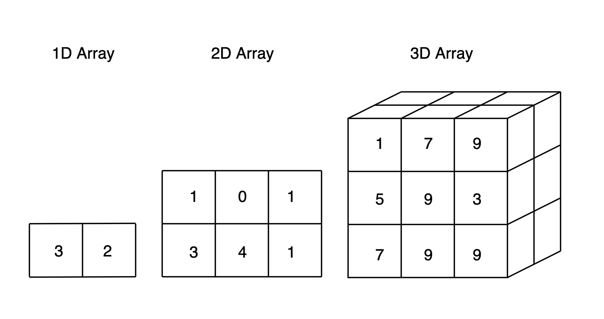
Lesson overview
An array is a group of variables. In Excel VBA, you can refer to a specific variable (element) of an array by using the array name and the index number.

Slide 4
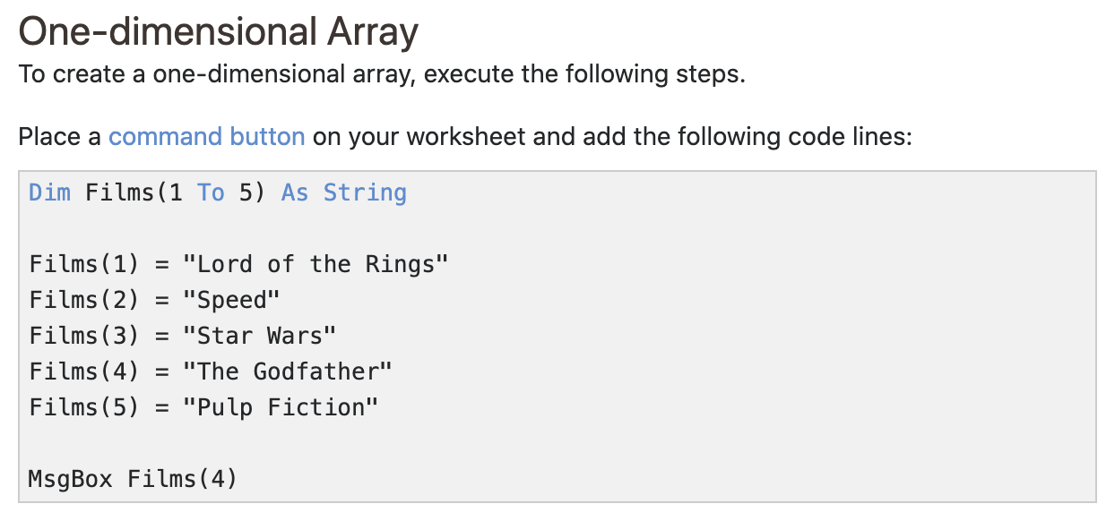
ONE DIMENSIONAL ARRAY

Slide 5
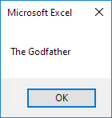
ONE DIMENSIONAL ARRAY
Result when you click the command button on the sheet:
Explanation: the first code line declares a String array with name Films. The array consists of five elements. Next, we initialize each element of the array. Finally, we display the fourth element using a MsgBox.

Slide 6
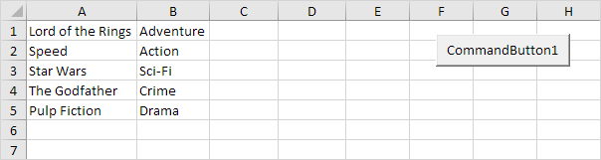
Two DIMENSIONAL ARRAY
Two-dimensional Array
To create a two-dimensional array, execute the following steps. This time we are going to read the names from the sheet.

Slide 7
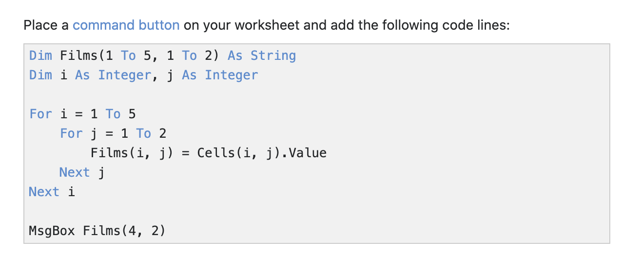
Two DIMENSIONAL ARRAY

Slide 8
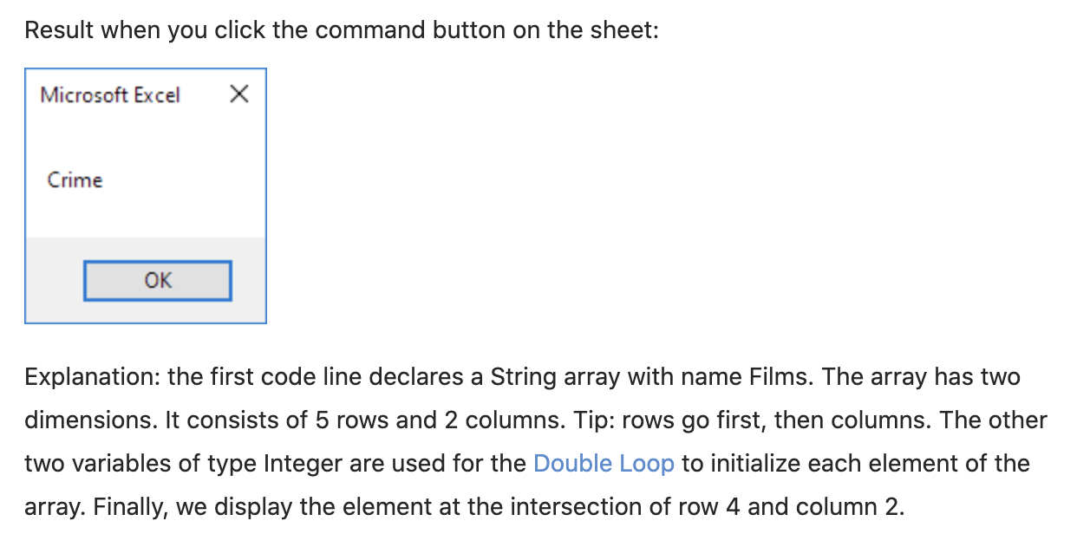
Two DIMENSIONAL ARRAY

Slide 9
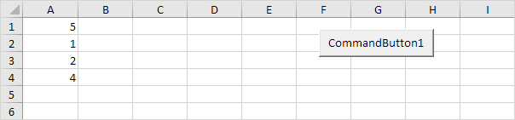
Dynamic Array
If the size of your array increases and you don't want to fix the size of the array, you can use the ReDim keyword. Excel VBA then changes the size of the array automatically.
Add some numbers to column A.

Slide 10
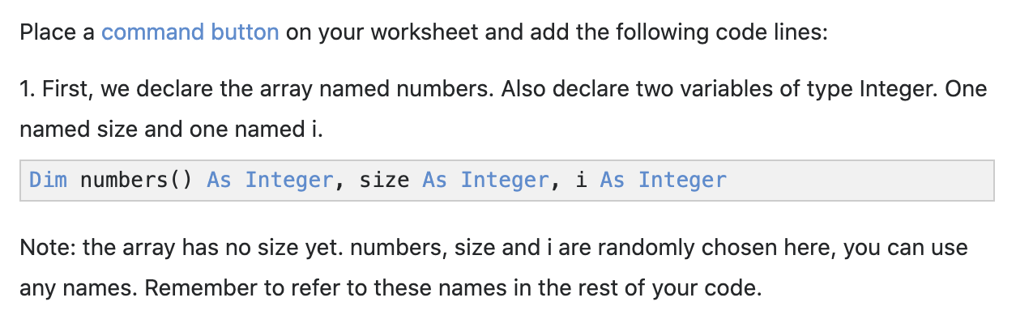
Dynamic Array

Slide 11
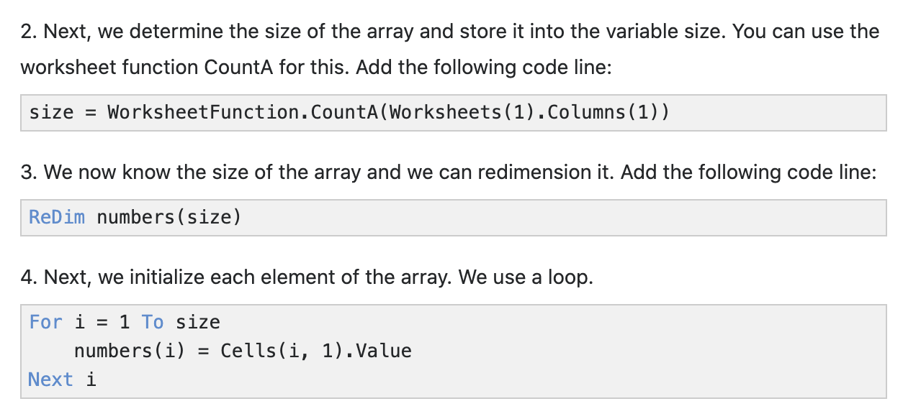
Dynamic Array

Slide 12
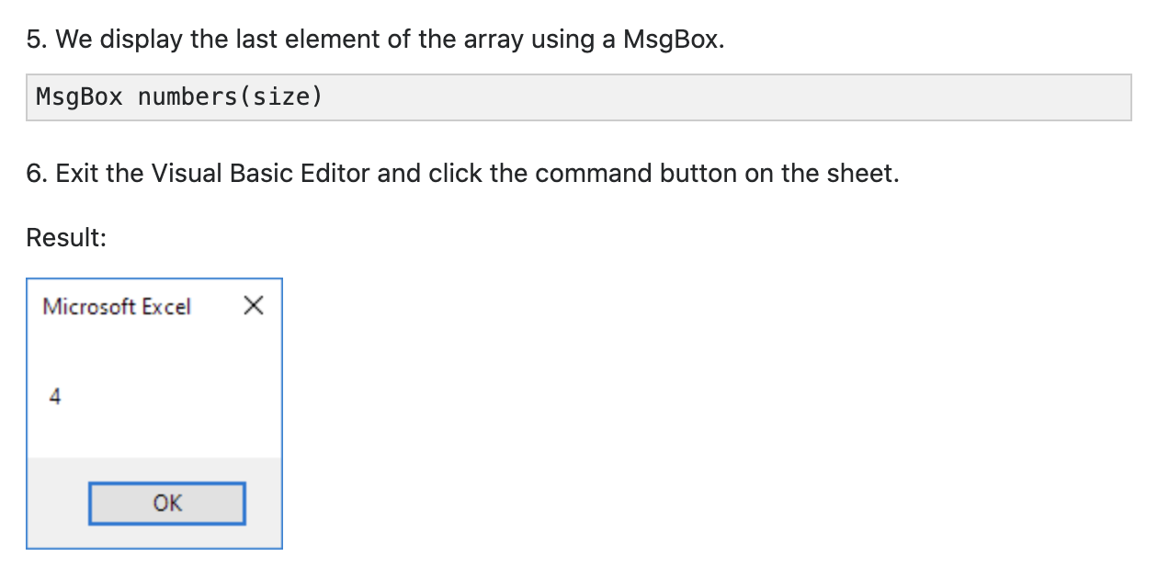
Dynamic Array

Slide 13
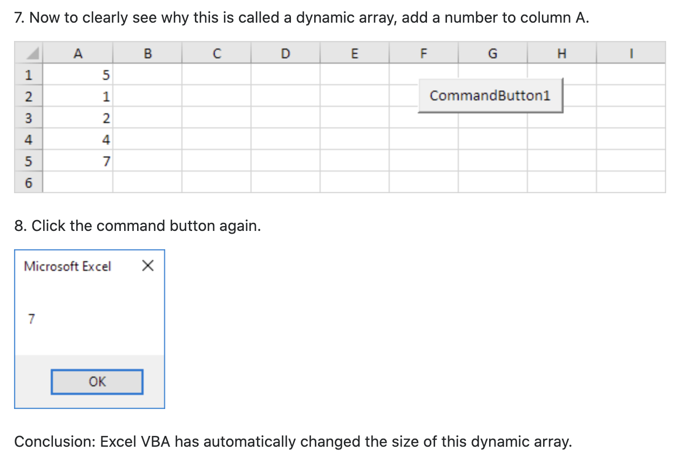
Dynamic Array

Slide 14
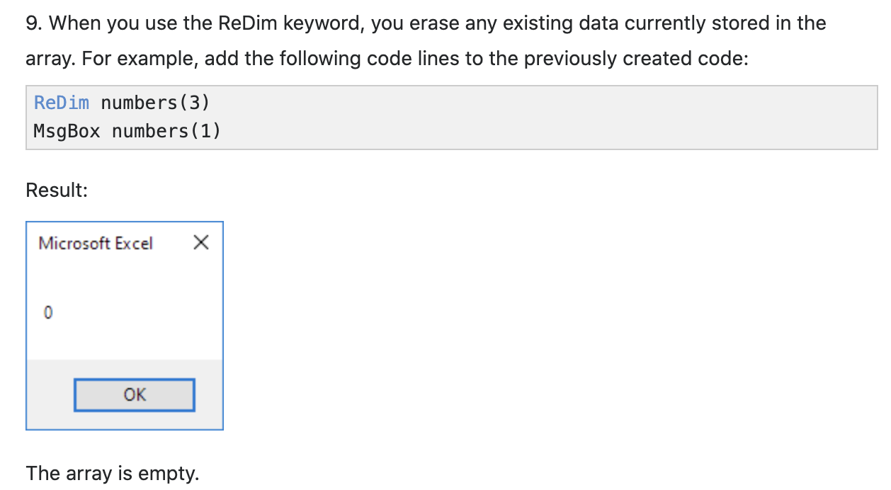
Dynamic Array

Slide 15
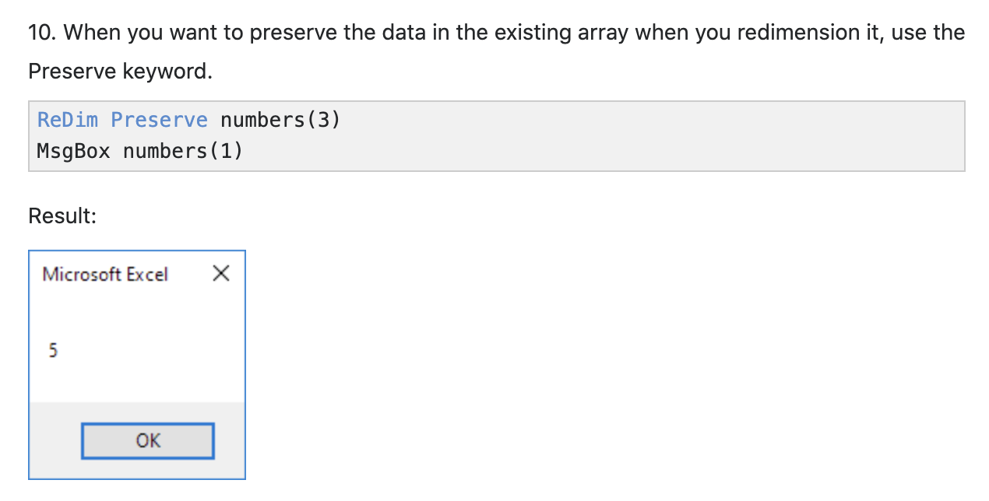
Dynamic Array

Slide 16
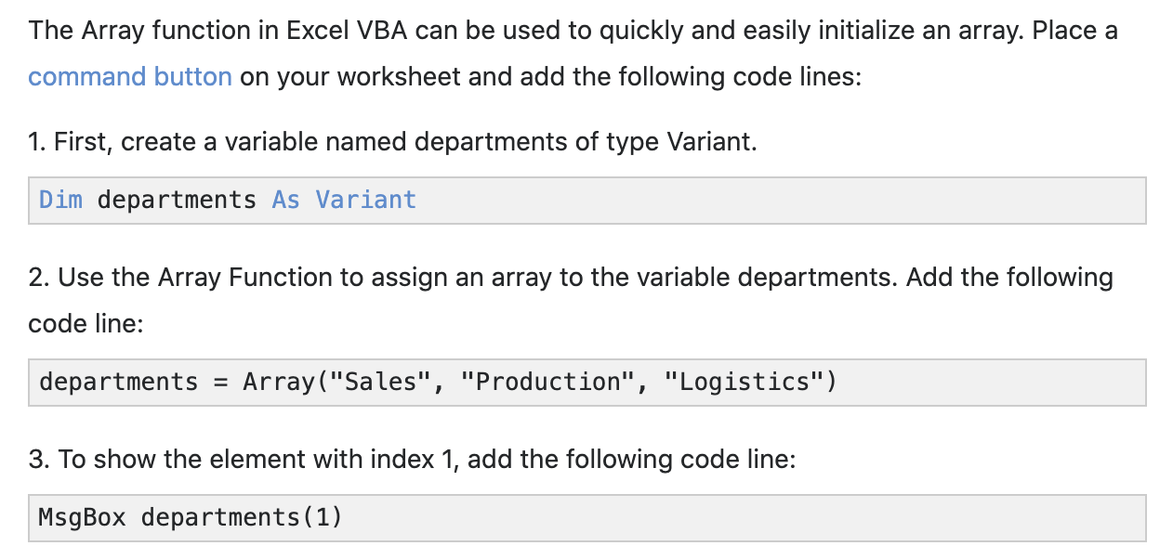
Array function

Slide 17
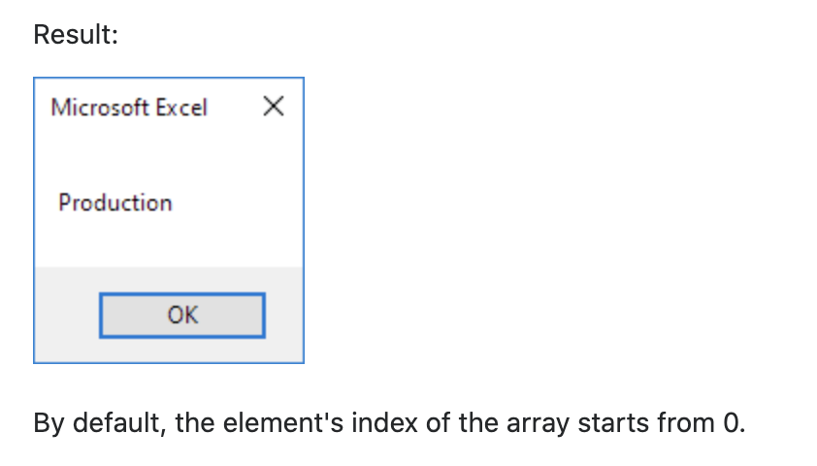
Array function
Visual Basics is a 0 based indexing programming language.

Slide 18
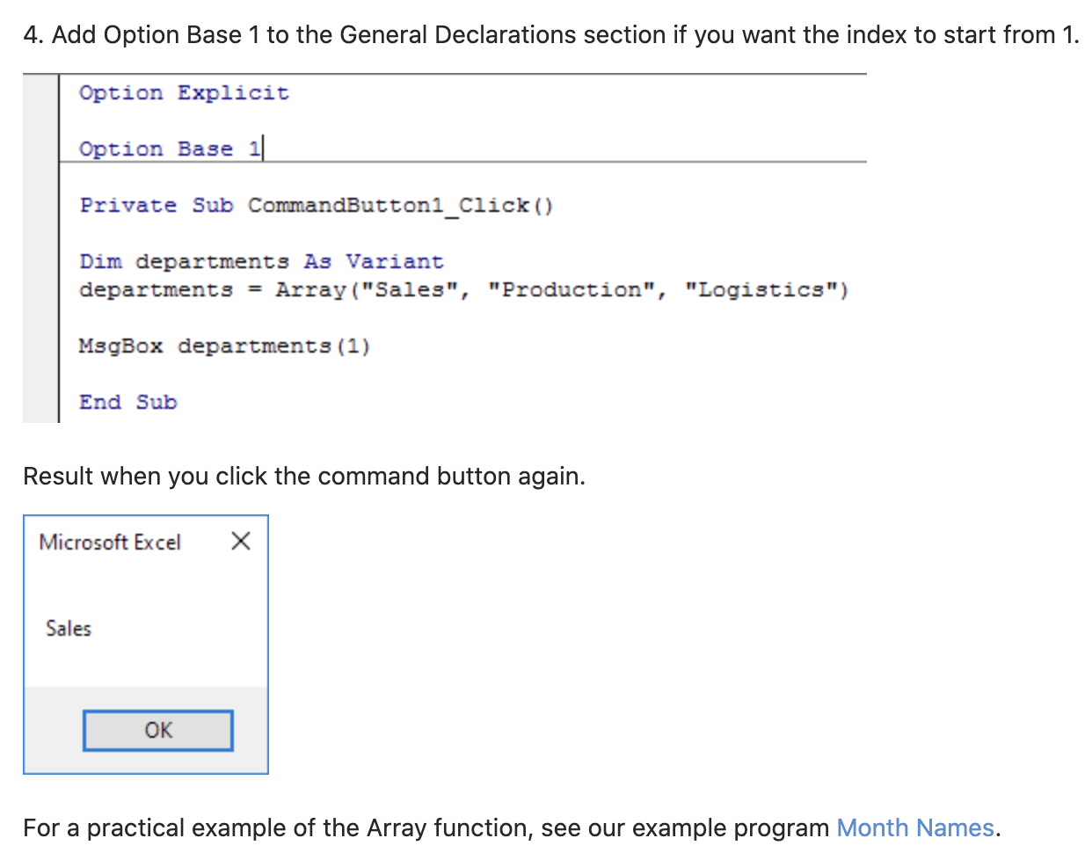
Array function

